Slide 1
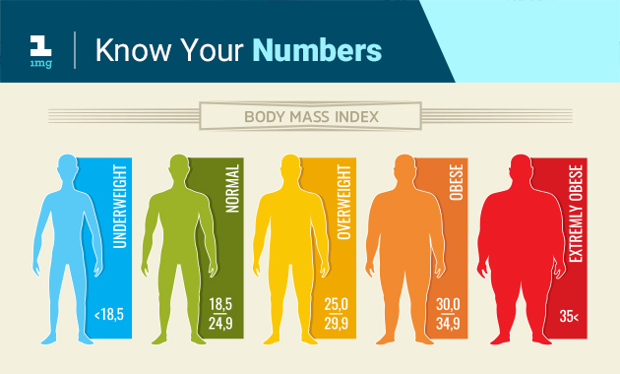
Quetelet index calculater
Dayan mukhtar shangroo
Ashish mehta
Krishna soni

Slide 2
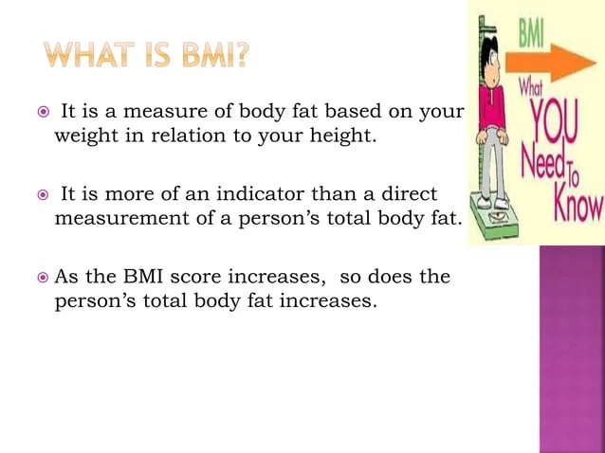

Slide 3
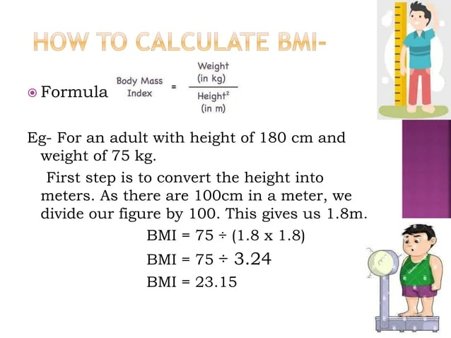

Slide 4
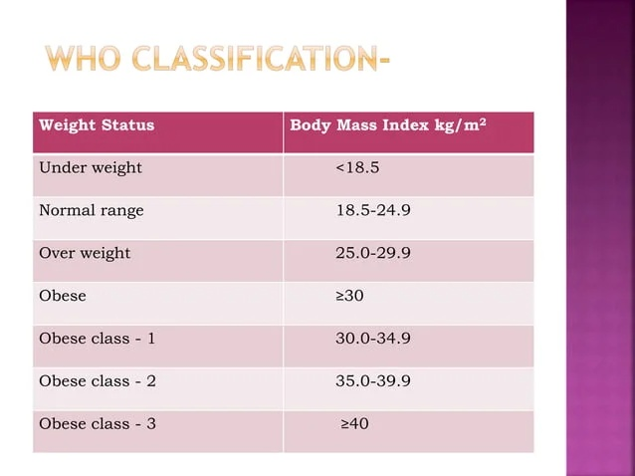

Slide 5
INTRODUCTION
In this project we have created a BMI (Body Mass Index) calculator using Java program . The program has a graphical user interface (GUI) created using the Swing framework. The user inputs their height (in cm), weight (in kg), gender, and date of birth. Upon clicking the submit button, the program calculates the user's BMI and displays it in a new window, along with a corresponding message about the user's weight status .The program consists of a main method and several helper methods, including the initialize method, which creates the GUI components and sets up event listeners, and the calculate_bmi method, which performs the BMI calculation and displays the result.The program makes use of several Swing components, including JLabels, JTextFields, JRadioButtons, JButtons, JComboBoxes, and JScrollPanes. It also uses a ButtonGroup to ensure that only one gender radio button can be selected at a time.
Overall, this program provides a simple and user-friendly way for individuals to calculate their BMI and learn more about their weight status.

Slide 6
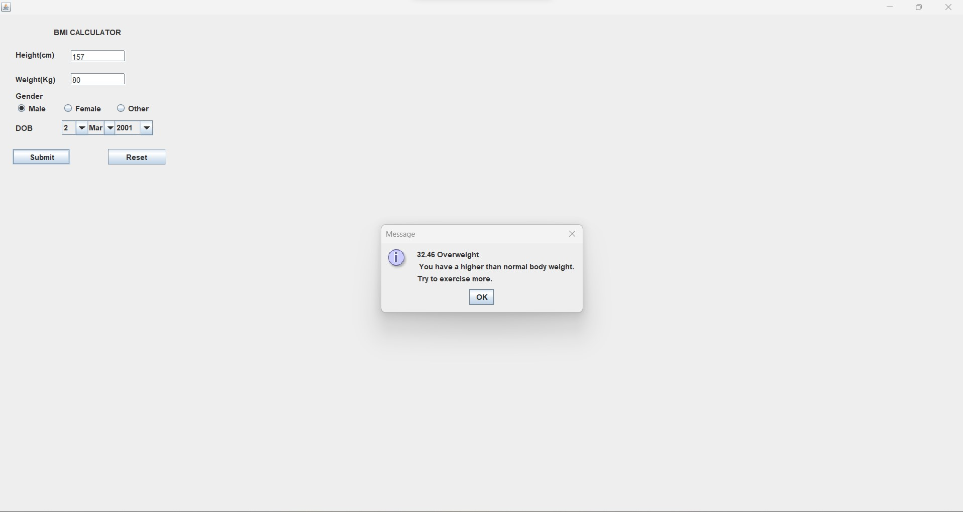
MODULE
This project is a GUI-based BMI (Body Mass Index) calculator that takes user inputs for height, weight, gender, and date of birth to calculate the BMI and provide a result.

Slide 7

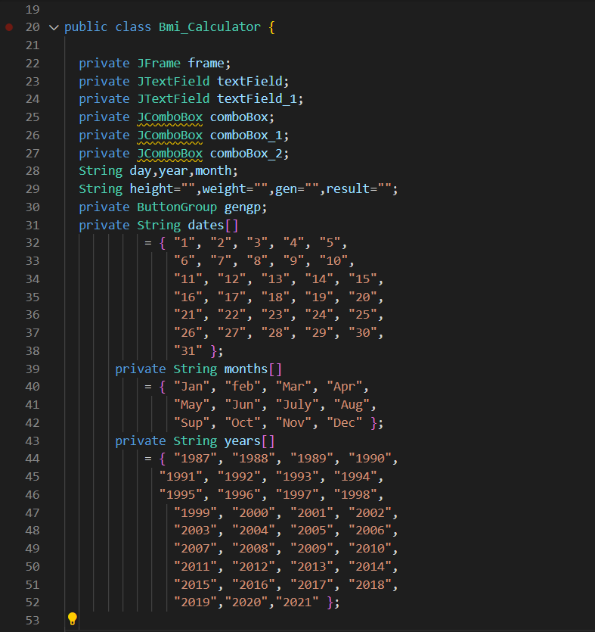
Sample Code

Slide 8
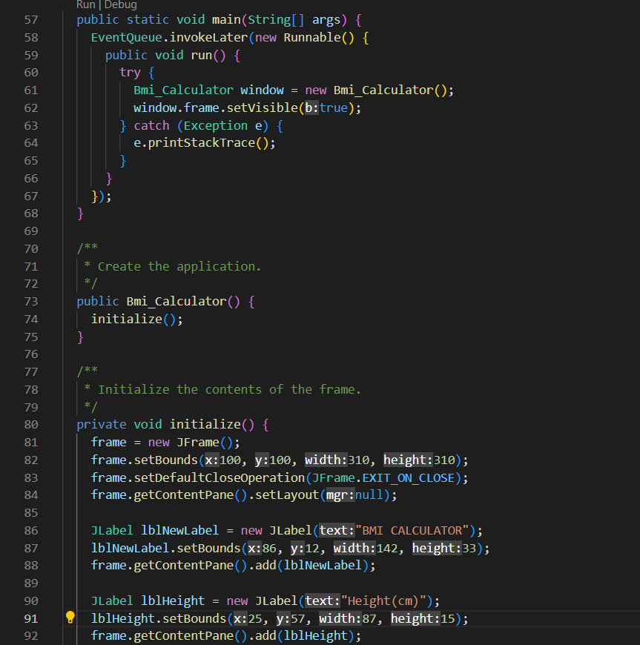
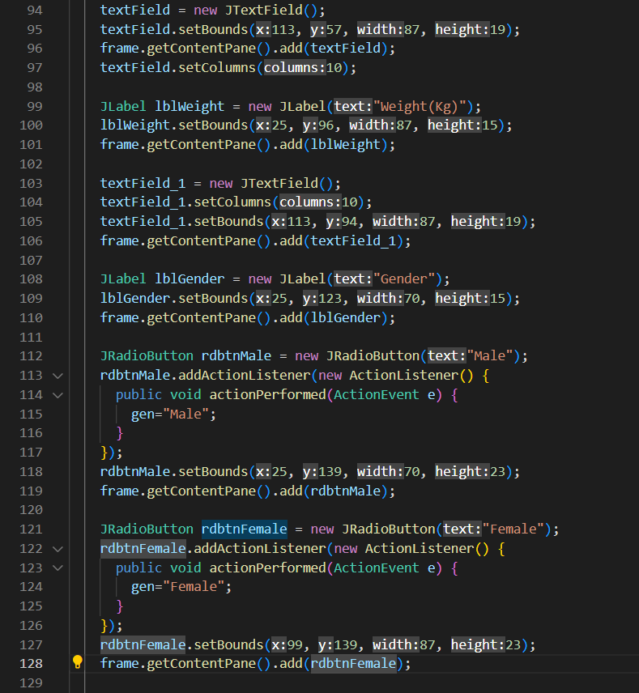

Slide 9
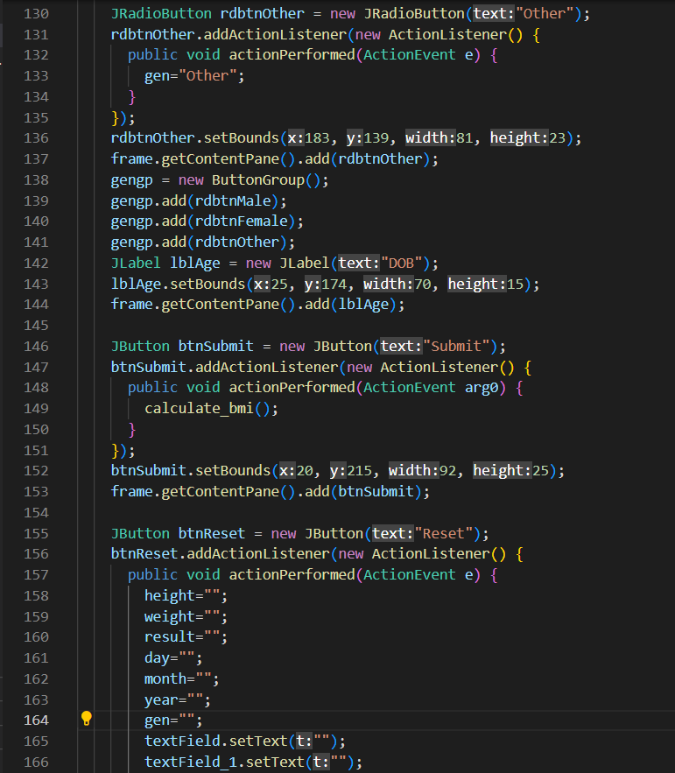
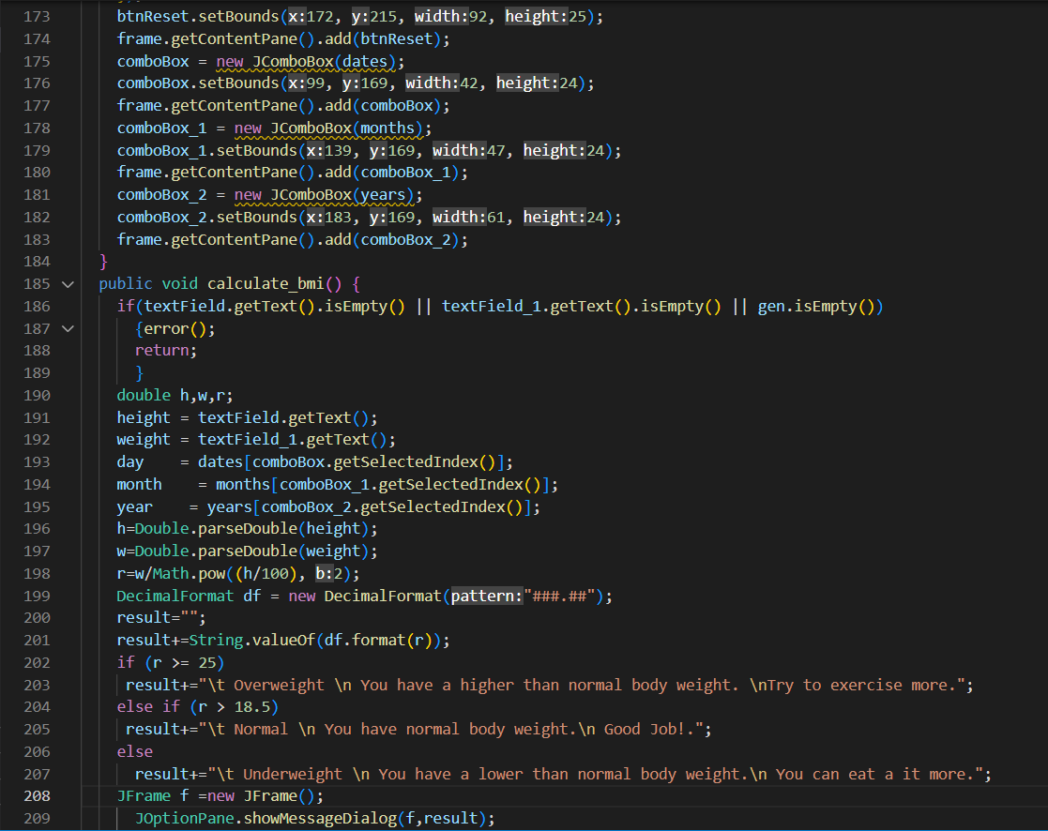

Slide 10
Future Enhancements
To improve this project, we can include a feature that suggests a healthy range for the user's BMI based on their age, gender, and other factors. This could provide helpful information and encourage the user to strive for a healthy weight. Additionally, it could be useful to include a feature that tracks the user's progress over time and allows them to set goals and track their BMI over a period. This could help motivate the user to maintain a healthy weight and lifestyle.

Slide 11
THANK YOU

